Slide 1


Electric Circuits
Twelfth Edition, Global Edition
Chapter 5 – Part 2
The Operational Amplifier
© 2024 Pearson Education Ltd. All Rights Reserved.
Notes:
If this PowerPoint presentation contains mathematical equations, you may need to check that your computer has the following installed:
1) Math Type Plugin
2) Math Player (free versions available)
3) NVDA Reader (free versions available)

Slide 2
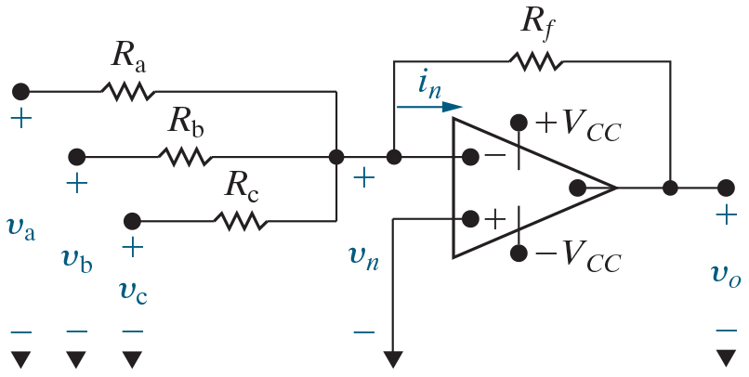

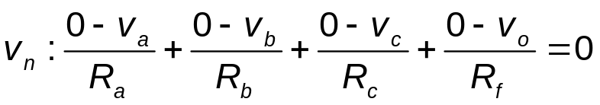
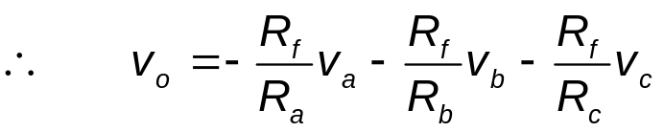

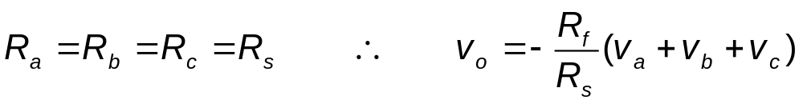
Chapter 5 – Op Amps (1 of 11)
Summing Amplifier
There is a negative feedback path, so assume linear operating region (Step 1). Using the ideal op amp assumptions, write a K C L equation at the non-inverting input (Step 2) and solve it (Step 3).
K C L at
for
If
If
Notes:
Long Description 1:
v subscript n Base Line: Start Fraction 0 minus v subscript a Base Line over R subscript a Base Line End Fraction plus Start Fraction 0 minus v subscript b Base Line over R subscript b Base Line End Fraction plus Start Fraction 0 minus v subscript c Base Line over R subscript c End Fraction plus Start Fraction 0 minus v subscript o Base Line over R subscript f End Fraction equals 0.
Long Description 2:
Therefore, v subscript o Base Line equals negative Start Fraction R subscript f Base Line over R subscript a Base Line End Fraction multiplied by v subscript a Base Line minus Start Fraction R subscript f Base Line over R subscript b End Fraction multiplied by v subscript b Base Line minus Start Fraction R subscript f Base Line over R subscript c End Fraction multiplied by v subscript c.
Long Description 3:
If R subscript a Base Line equals R subscript b Base Line equals R subscript c Base Line equals R subscript s Base Line, therefore, v subscript o Base Line equals negative Start Fraction R subscript f over R subscript s End Fraction Open Parenthesis v subscript a Base Line plus v subscript b Base Line plus v subscript c Base Line Close Parenthesis.
Long Description 4:
If R subscript a Base Line equals R subscript b Base Line equals R subscript c Base Line equals R subscript s Base Line equals R subscript f Base Line. Therefore, v subscript o Base Line equals negative Open Parenthesis v subscript a Base Line plus v subscript b Base Line plus v subscript c Close Parenthesis.

Slide 3
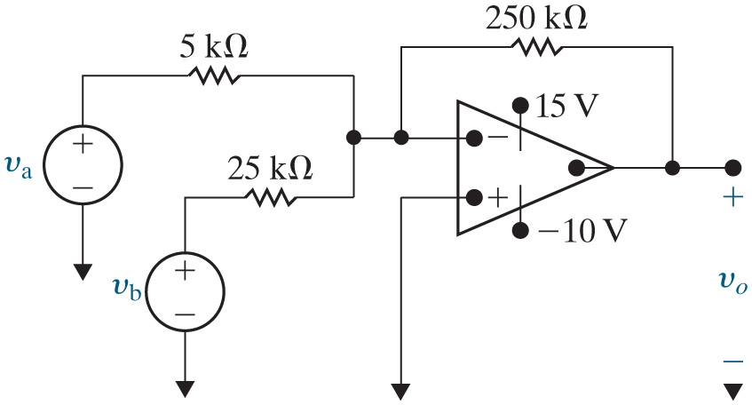



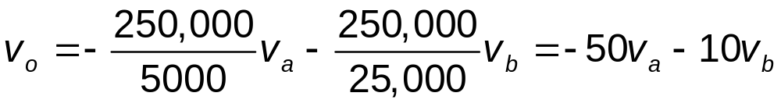

Chapter 5 – Op Amps (2 of 11)
Summing Amplifier Example
Find
if
and
Is
Yes!
Notes:
Long Description:
v subscript o Base Line equals negative Start Fraction 250,000 over 5000 End Fraction multiplied by v subscript a Base Line minus Start Fraction 250,000 over 25,000 End Fraction multiplied by v subscript b Base Line equals negative 50 v subscript a Base Line minus 10 v subscript b.

Slide 4


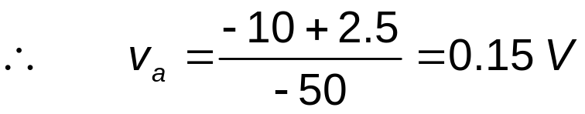
Chapter 5 – Op Amps (3 of 11)
Summing Amplifier Example, continued
If
what positive
value of
causes the op amp
to saturate?

Slide 5



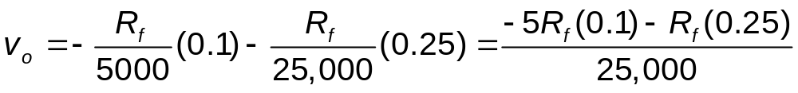
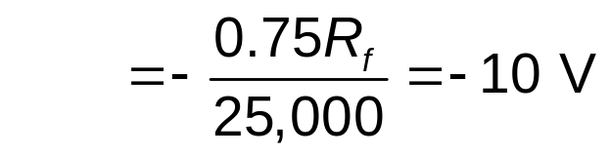
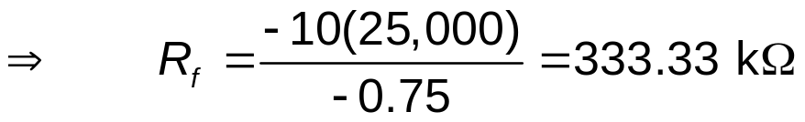
Chapter 5 – Op Amps (4 of 11)
Summing Amplifier Example, continued
If the
feedback resistor is
replaced with a variable resistor, how large can it be before the op
amp saturates? Assume
and
Notes:
Long Description:
v subscript o Base Line equals negative Start Fraction R subscript f over 5000 End Fraction multiplied by Open Parenthesis 0.1 Close Parenthesis minus Start Fraction R subscript f over 25,000 End Fraction multiplied by Open Parenthesis 0.25 Close Parenthesis equals Start Fraction negative 5 R subscript f Base Line multiplied by Open Parenthesis 0.1 Close Parenthesis minus R subscript f Base Line multiplied by Open Parenthesis 0.25 Close Parenthesis over 25,000 End Fraction.

Slide 6
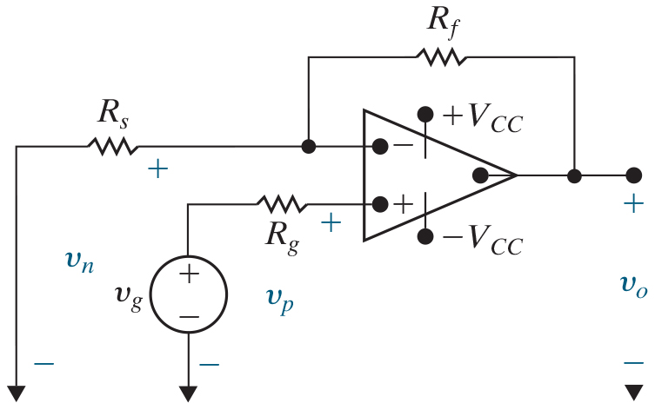
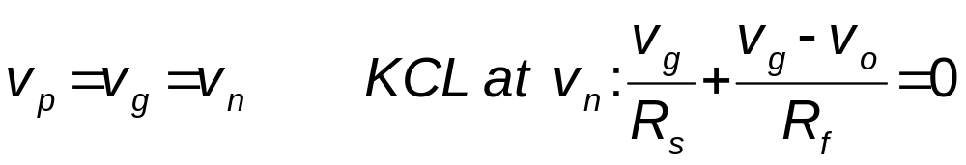
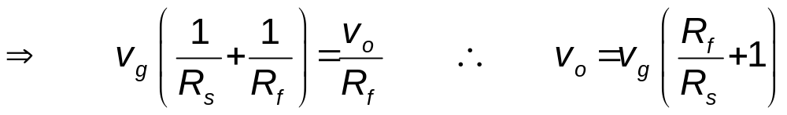
Chapter 5 – Op Amps (5 of 11)
Non-inverting Amplifier
There is a negative feedback path, so assume linear operating region (Step 1). Using the ideal op amp assumptions, write a K C L equation at the non-inverting input (Step 2) and solve it (Step 3).
Notes:
Long Description 1:
v subscript p Base Line equals v subscript g Base Line equals v subscript n Base Line; K C L at v subscript n Base Line: Start Fraction v subscript g over R subscript s End Fraction plus Start Fraction v subscript g Base Line minus v subscript o over R subscript f End Fraction equals 0.
Long Description 2:
Forward arrow, v subscript g Base Line Open Parenthesis Start Fraction 1 over R subscript s End Fraction plus Start Fraction 1 over R subscript f End Fraction Close Parenthesis equals Start Fraction v subscript o over R subscript f End Fraction. Therefore, v subscript o Base Line equals v subscript g Base Line Open Parenthesis Start Fraction R subscript f over R subscript s End Fraction plus 1 Close Parenthesis.

Slide 7


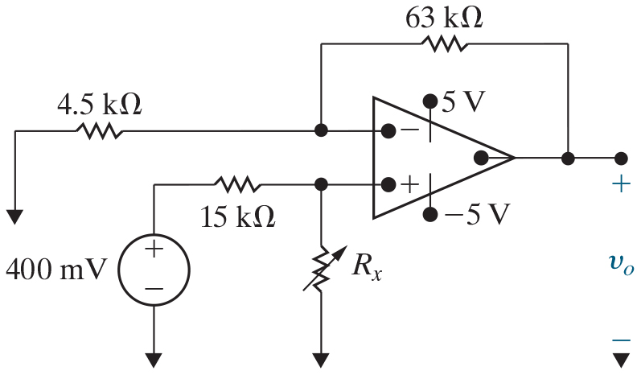

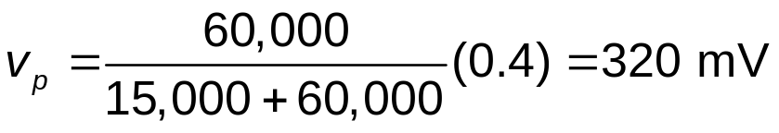

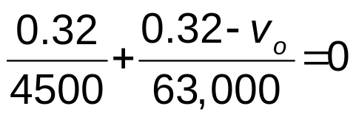


Chapter 5 – Op Amps (6 of 11)
Non-inverting Amplifier Example
Assume
Find
Use voltage division to find
Now use K C L at the inverting input to find

Slide 8

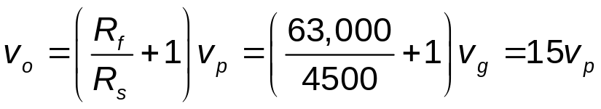
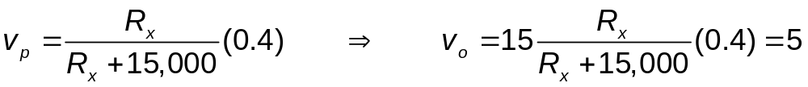
Chapter 5 – Op Amps (7 of 11)
Non-inverting Amplifier Example, continued
Find the value of
that will cause the op amp to saturate.
Notes:
Long Description 1:
v subscript o Base Line equals Open Parenthesis Start Fraction R subscript f over R subscript s End Fraction plus 1 Close Parenthesis v subscript p Base Line equals Open Parenthesis Start Fraction 63,000 over 4500 End Fraction plus 1 Close Parenthesis multiplied by v subscript g Base Line equals 15 v subscript p.
Long Description 2:
v subscript p Base Line equals Start Fraction R subscript x over R subscript x Base Line plus 15,000 End Fraction multiplied by Open Parenthesis 0.4 Close Parenthesis, forward arrow, v subscript o Base Line equals 15 Start Fraction R subscript x over R subscript x Base Line plus 15,000 End Fraction Open Parenthesis 0.4 Close Parenthesis equals 5.

Slide 9
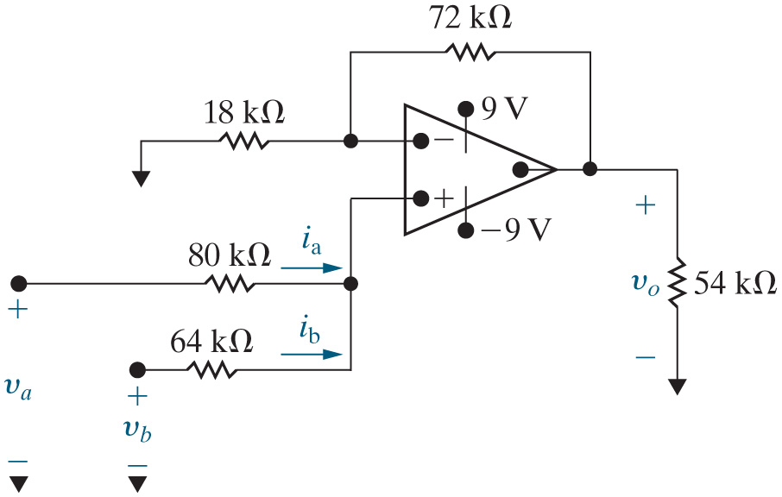
Chapter 5 – Op Amps (8 of 11)
What op amp circuit configuration is shown here? (Hints – how many inputs are there, and where are those inputs connected to the op amp?)
A. Inverting amplifier
B. Inverting summing amplifier
C. Non-inverting amplifier
D. Non-inverting summing amplifier

Slide 10


Chapter 5 – Op Amps (8 of 11)
What op amp circuit configuration is shown here? (Hints – how many inputs are there, and where are those inputs connected to the op amp?)
A. Inverting amplifier
B. Inverting summing amplifier
C. Non-inverting amplifier
D. Non-inverting summing amplifier

Slide 11
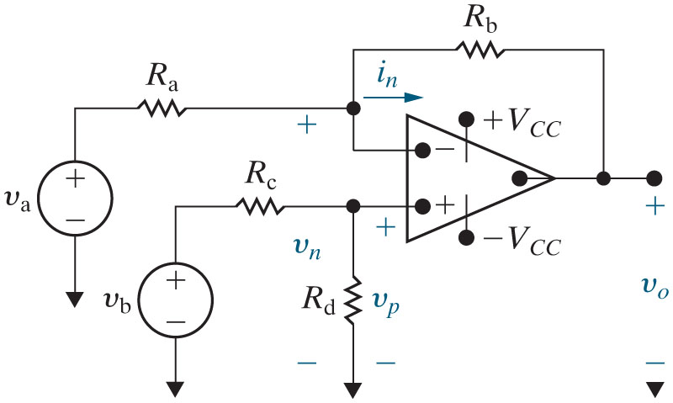
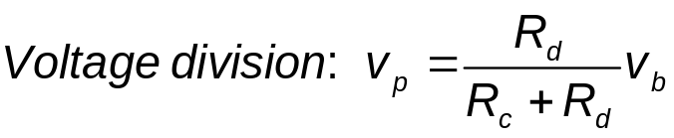
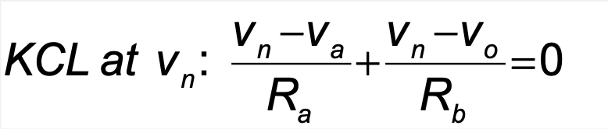

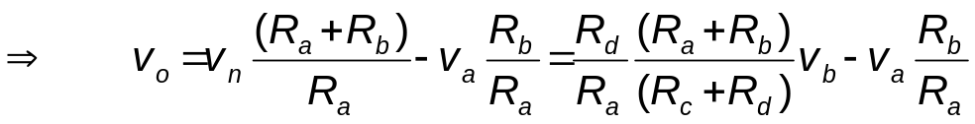
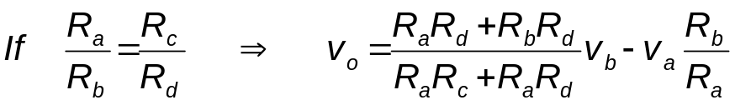
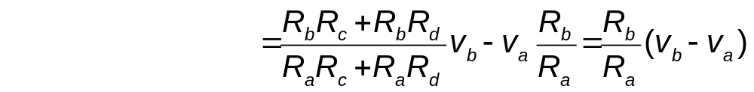
Chapter 5 – Op Amps (9 of 11)
Difference amplifier
Notes:
Long Description 1:
K C L at v subscript n Base Line: Start Fraction v subscript n Base Line minus v subscript a over R subscript a End Fraction plus Start Fraction v subscript n Base Line minus v subscript o over R subscript b End Fraction equals 0, forward arrow, Start Fraction R subscript b Base Line Open Parenthesis v subscript n Base Line minus v subscript a Close Parenthesis plus R subscript a Base Line multiplied by Open Parenthesis v subscript n Base Line minus v subscript o Close Parenthesis over R subscript a Base Line plus R subscript b End Fraction equals 0.
Long Description 2:
Forward arrow, v subscript o Base Line equals v subscript n Base Line Start Fraction Open Parenthesis R subscript a Base Line plus R subscript b Close Parenthesis over R subscript a End Fraction minus v subscript a Base Line multiplied by Start Fraction R subscript b over R subscript a End Fraction equals Start Fraction R subscript d over R subscript a End Fraction multiplied by Start Fraction Open Parenthesis R subscript a Base Line plus R subscript b Close Parenthesis over Open Parenthesis R subscript c Base Line plus R subscript d Close Parenthesis End Fraction multiplied by v subscript b Base Line minus v subscript a Base Line Start Fraction R subscript b over R subscript a End Fraction.
Long Description 3:
Forward arrow, v subscript o Base Line equals Start Fraction R subscript a Base Line R subscript d Base Line plus R subscript b Base Line R subscript d over R subscript a Base Line R subscript c Base Line plus R subscript a Base Line R subscript d End Fraction multiplied by v subscript b Base Line minus v subscript a Base Line Start Fraction R subscript b over R subscript a End Fraction.
Long Description 4:
Equals Start Fraction R subscript b Base Line R subscript c Base Line plus R subscript b Base Line R subscript d over R subscript a Base Line R subscript c Base Line plus R subscript a Base Line R subscript d End Fraction multiplied by v subscript b Base Line minus v subscript a Base Line Start Fraction R subscript b over R subscript a End Fraction equals Start Fraction R subscript b over R subscript a End Fraction multiplied by Open Parenthesis v subscript b Base Line minus v subscript a Close Parenthesis.

Slide 12


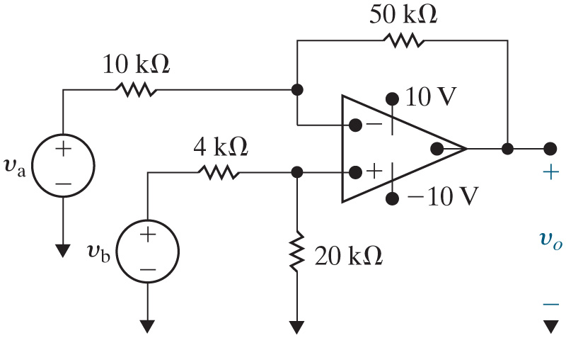
Chapter 5 – Op Amps (10 of 11)
In a difference amplifier, if
we can use the simple
expression
  Can we use this simple expression for the circuit shown?
A. Yes
B. No

Slide 13


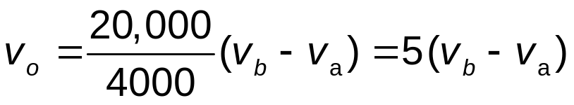


Chapter 5 – Op Amps (11 of 11)
Difference amplifier Example
Suppose
What range
of values for
will assure that
the op amp operates within its linear region?
Use the simplified equation:
Notes:
Long Description:
v subscript o Base Line equals Start Fraction 20,000 over 4000 End Fraction multiplied by Open Parenthesis v subscript b Base Line minus v subscript a Close Parenthesis equals 5 multiplied by Open Parenthesis v subscript b Base Line minus v subscript a Close Parenthesis.

Slide 14

Copyright
This work is protected by United Kingdom copyright laws and is provided solely for the use of instructors in teaching their courses and assessing student learning. Dissemination or sale of any part of this work (including on the World Wide Web) will destroy the integrity of the work and is not permitted. The work and materials from it should never be made available to students except by instructors using the accompanying text in their classes. All recipients of this work are expected to abide by these restrictions and to honor the intended pedagogical purposes and the needs of other instructors who rely on these materials.

